Slide 1
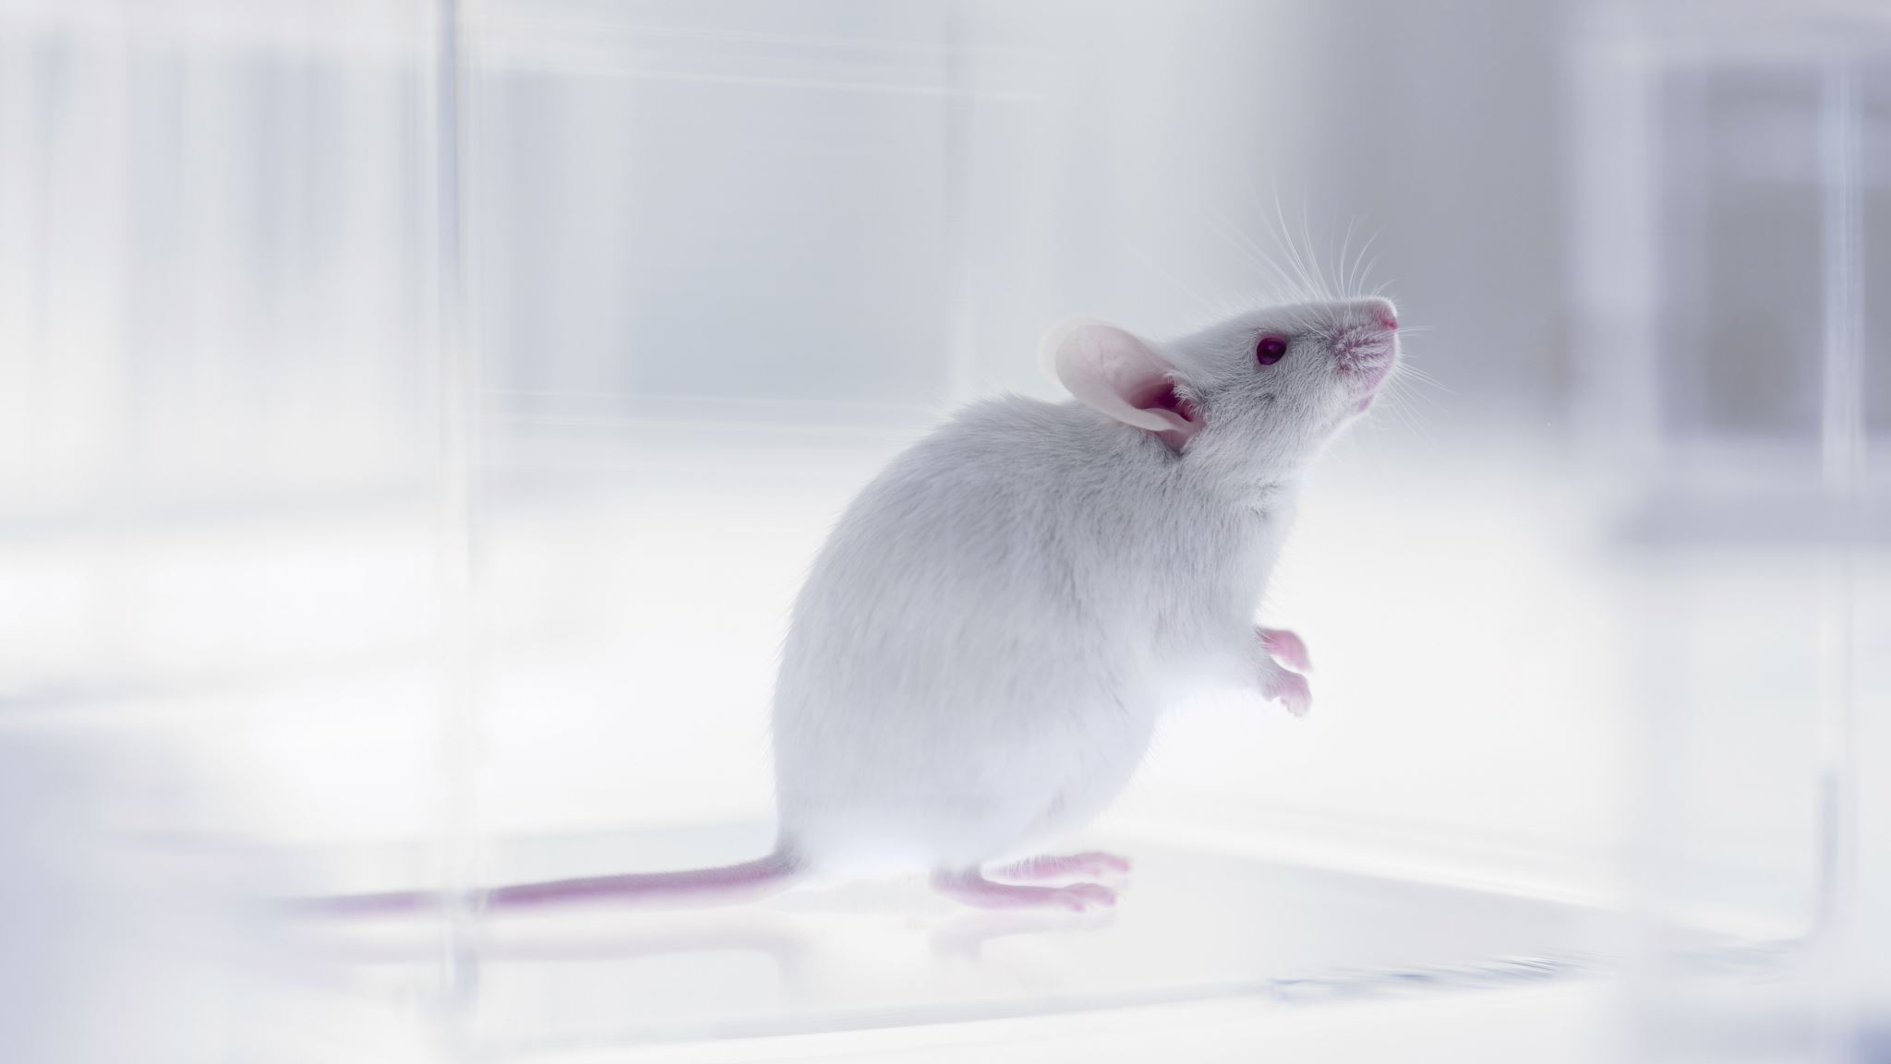
NYC 311 Rodent Data
Visualizations by Lina
Using Tableau
Data from Jan 2010 – May 2022
Github.com/leelina024

Slide 2
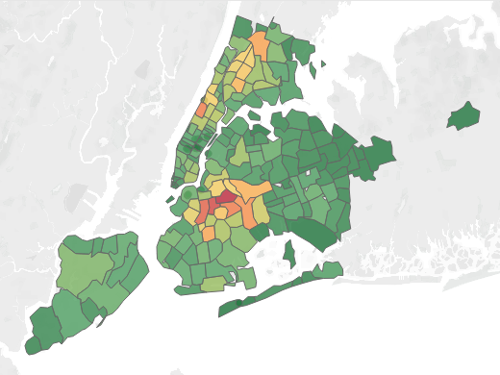
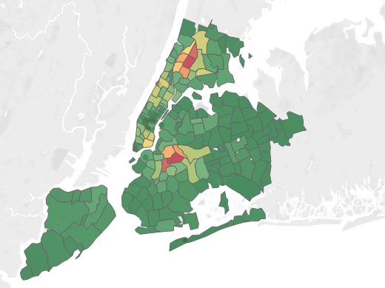
Number of Complaints by Zip Code
Number of Inspections by Zip Code
Github.com/leelina024

Slide 3
Rodent Zip Code Findings
Most Complained Zip Codes
11233 (BK)
10025 (NY)
11226 (BK)
11385 (QNY)
10456 (BX)
Most Inspected Zip Codes
11221 (BK)
10457 (BX)
11216 (BK)
10458 (BX)
10456 (BX)
There are more rodent inspections in Brooklyn and Bronx compared to their portion distribution of complaints.
10456 is the only zip code that is consistent with complaints and inspections.
Github.com/leelina024

Slide 4
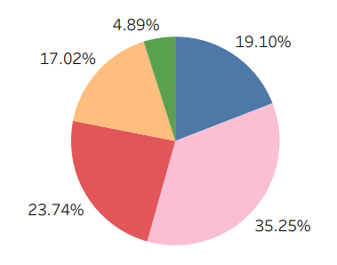
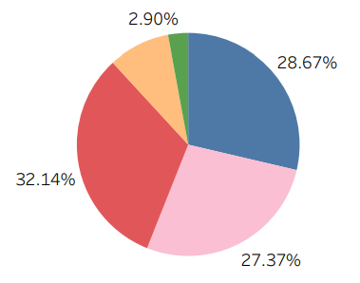
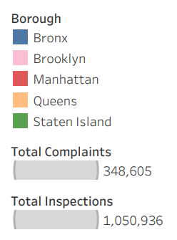
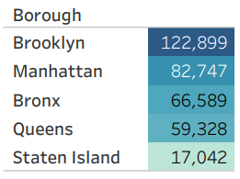
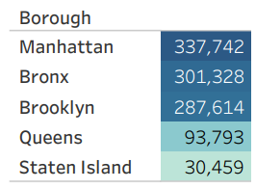
Number of Complaints
per Borough
Number of Inspections
per Borough
Github.com/leelina024

Slide 5
Rodent Borough Findings
The most complained borough is Brooklyn, followed by Manhattan.
The most inspected borough is Manhattan, followed by the Bronx and Brooklyn.
Although citizens complain of rodent sightings in Brooklyn the most, the city inspects Manhattan and Bronx more than their share of complaints.
Github.com/leelina024

